Slide 1
Detection of Air Pollutants
ACM_01
THEME - culture and heritage

Slide 2
Table of contents
01
Problem Statement
02
Problem Description
03
Solutions and its working
Technologies Used
04
04
05
Prototype

Slide 3

01
Problem Statement
Over the years the culture and heritage of India has been affected and lost their quintessence. One of the main reasons is air pollution. Our main objective is to visualize the air quality and major pollutants present in air provide suggestions on the same.

Slide 4
Problem Description
02
In a developing country like India, culture and heritage are one of the most attractive things around the world. One of the major impacts on culture and heritage is climate change and air pollution. Since we are very much interested in westernization, people want to upgrade their status symbol by buying cars, private jets, etc. All this process in turn affects the air quality and causes pollution which indirectly affects the culture and heritage on a large scale. We are using machine learning to detect air pollutants and provide suggestions to improve the air quality.

Slide 5



Technologies Used
Machine Learning
User Interface
Languages used
04
Linear regression
GUI
python

Slide 6
SWOT Analysis
STRENGTHS Helps monitor air pollution control programs We can understand mortality rates and over the years and data collected can be devised for protection | WEAKNESS It can't detect the particulate less than pm2.5
OPPORTUNITIES Sensors are smaller, lower power requirements and can be easily deployed | THREATS The specification has some detection limit, like particle size range,accuracy and precision which is not always comparable

Slide 7
Future Developments
05
Sensors like MiCS 6814, MQ135, MQ131, PM 2.5 as part of iot can be combined with machine learning to provide real time showcase we can directly detect the pollutants from the air.
Nano filters we can use in the Exhaust Systems of the vehicle to directly filter the pollutants like co which is emitted in the air.
The government advisories can use the same to issue alert messages that can be sent general public through SMS or emails.

Slide 8
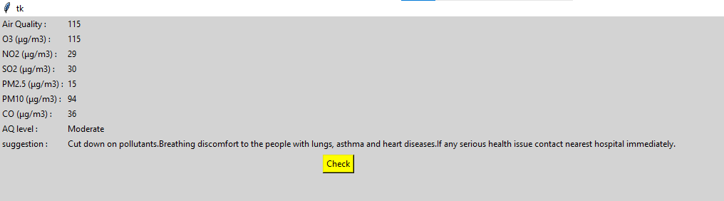
Prototype

Slide 9
Thank you!!!
Have a nice day

